Slide 1
Architecture Design

Slide 2
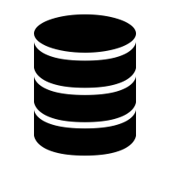



Design Using Bigdata tools
Approach : 1
Dumping processed data in HDFS or RDBMS or CSV
Sqoop
Spark Job reading data from HDFS
Processed data
NOTE: We will not be using this approach as Sqoop is not a viable option as it has high resource consumption.

Slide 3
Design Using Bigdata tools
Approach 2 :
Dumping processed data in HDFS or RDBMS or CSV
Processed data
Spark can read data from RDBMS using JDBC connection

Slide 4
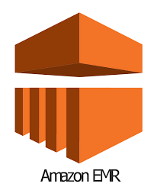




Design on AWS
Amazon S3
Lambda for submitting Spark Job
Amazon S3
Raw sale data in s3
Processed data in s3

Slide 5
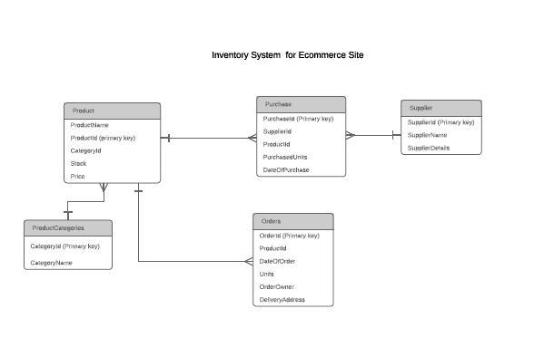
ER Diagram

